Slide 1


Machine Learning LAB
Week 03

Slide 2
Lab Contents
Logistic Regression
Polynomial Regression

Slide 3
Logistic Regression (Scratch)
Logistic Regression from scratch

Slide 4
Logistic Regression (Scratch)
it's also known as logit regression
Use for classification.
Help in decision making.
Where the situation is not clear you do not know the outcome results.
in regression dependent variable was continuous.
In this dependent variables is binary 0 or 1 or binomial.
Used in decision making so it support probability.
probability range is 0-1.
Binary classification it means that only two outcomes.
Multi class means different classes.

Slide 5
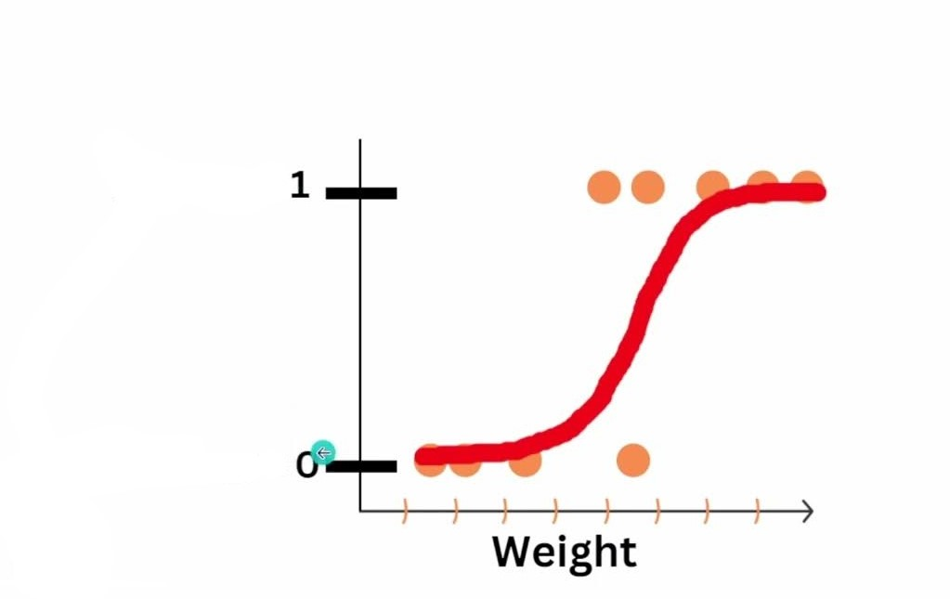
Logistic Regression (Scratch)
in linear relation we can draw straight line to classify but in this we can’t.
The outcome is form of s.
Backend working sigmoid or logit function
Sigmoid probability is equal to 1 / 1 + e^{-z}. So e Euler's number = 2.7
Z is equal to linear equation equation y= mx+b...
it converts input into 0 1 range...

Slide 6
Logistic Regression (Scratch)
import numpy as np
import pandas as pd
from sklearn.model_selection import train_test_split
from sklearn.preprocessing import StandardScaler, LabelEncoder
from sklearn.metrics import accuracy_score, classification_report, confusion_matrix
# Load the dataset from a CSV file
data = pd.read_csv('/content/Social_Network_Ads.csv')

Slide 7
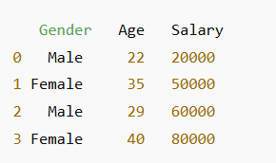
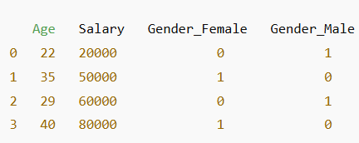
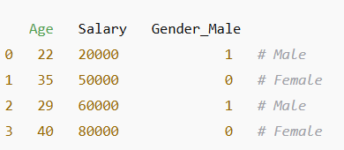
Logistic Regression (Scratch)
# Preprocessing
# Encode categorical variable 'Gender'
data = pd.get_dummies(data, columns=['Gender'], drop_first=True)
# Define features and target variable
X = data[['Gender_Male', 'Age', 'EstimatedSalary']].values
y = data['Purchased'].values # Target variable

Slide 8
Logistic Regression (Scratch)
# Split the dataset into training and testing sets
X_train, X_test, y_train, y_test = train_test_split(X, y, test_size=0.2, random_state=42)
# Scale the features
scaler = StandardScaler()
X_train = scaler.fit_transform(X_train)
X_test = scaler.transform(X_test)

Slide 9
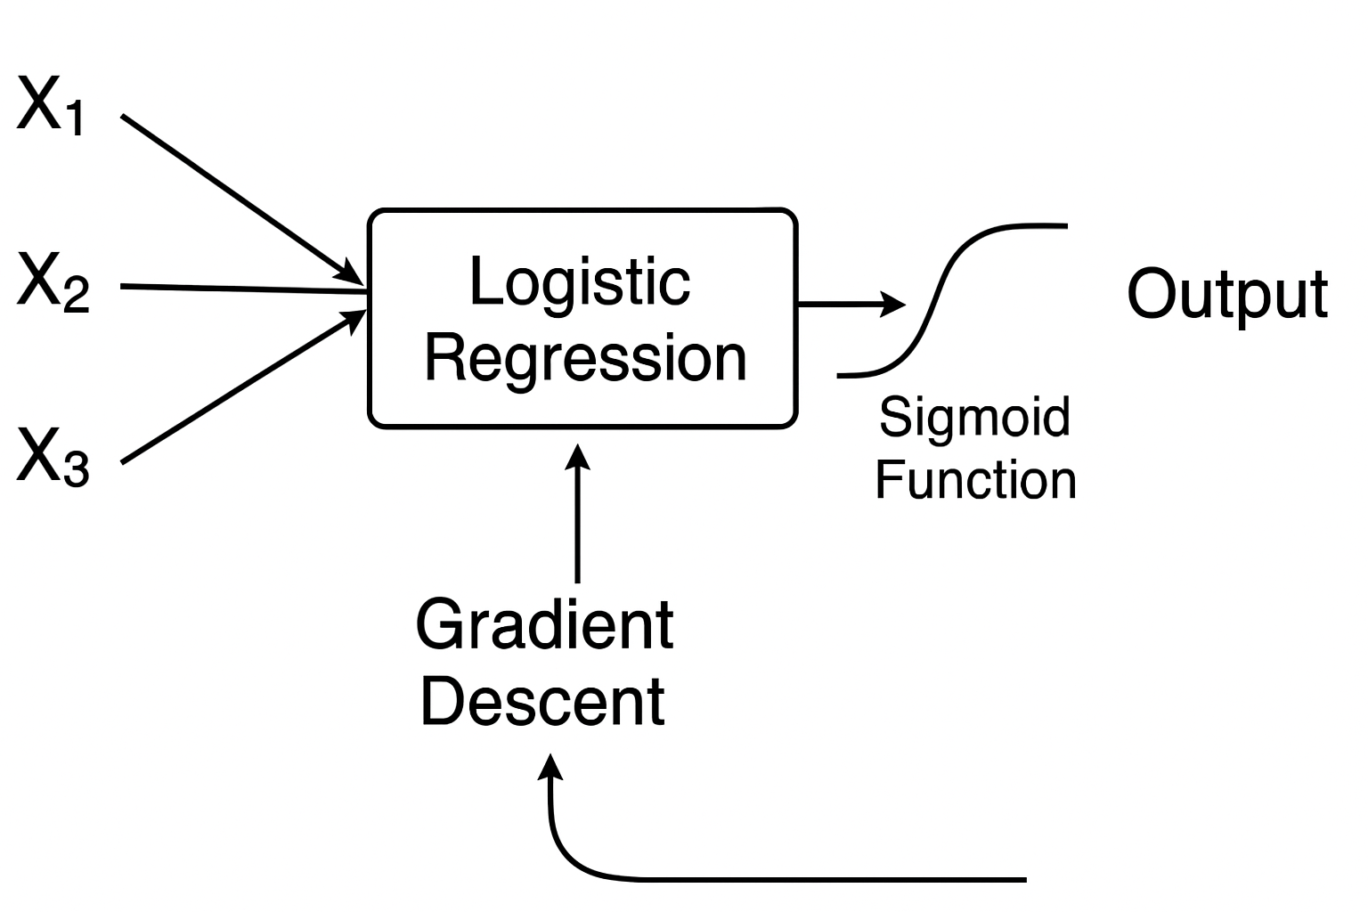
Logistic Regression (Scratch)
# Logistic Regression Implementation
class LogisticRegression:
def __init__(self, learning_rate=0.01, num_iterations=1000):
self.lr = learning_rate
self.iterations = num_iterations
self.weights = None
self.bias = None
def sigmoid(self, z):
return 1 / (1 + np.exp(-z))
def fit(self, X, y):
num_samples, num_features = X.shape
self.weights = np.zeros(num_features)
self.bias = 0

Slide 10
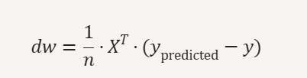
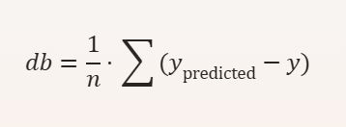
Logistic Regression (Scratch)
for i in range(self.iterations):
linear_model = np.dot(X, self.weights) + self.bias
y_predicted = self.sigmoid(linear_model)
# Update weights and bias by calculating Gradient
dw = (1 / num_samples) * np.dot(X.T, (y_predicted - y))
db = (1 / num_samples) * np.sum(y_predicted - y)
self.weights -= self.lr * dw
self.bias -= self.lr * db
def predict(self, X):
linear_model = np.dot(X, self.weights) + self.bias
return [1 if i > 0.5 else 0 for i in self.sigmoid(linear_model)]

Slide 11
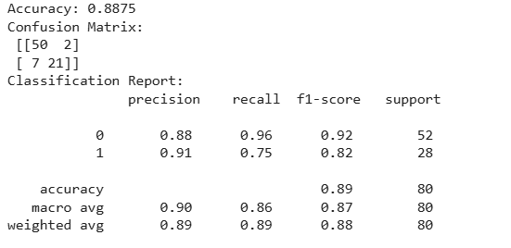
Logistic Regression (Scratch)
# Train the Model
model = LogisticRegression(learning_rate=0.1, num_iterations=1000)
model.fit(X_train, y_train)
# Evaluate the Model
predictions = model.predict(X_test)
print("Accuracy:", accuracy_score(y_test, predictions))
print("Confusion Matrix:\n", confusion_matrix(y_test, predictions))
print("Classification Report:\n", classification_report(y_test, predictions))

Slide 12
Logistic Regression (Sklearn)
import pandas as pd
from sklearn.model_selection import train_test_split
from sklearn.preprocessing import StandardScaler, LabelEncoder
from sklearn.linear_model import LogisticRegression
from sklearn.metrics import accuracy_score, confusion_matrix, classification_report
# Load dataset
data = pd.read_csv("/content/Social_Network_Ads.csv")
# Encode Gender (Male/Female → 1/0)
le = LabelEncoder()
data['Gender'] = le.fit_transform(data['Gender'])

Slide 13
Logistic Regression (Sklearn)
# Features & target
X = data[['Gender', 'Age', 'EstimatedSalary']].values
y = data['Purchased'].values
# Train-test split
X_train, X_test, y_train, y_test = train_test_split(X, y, test_size=0.2, random_state=42)
# Scale features
scaler = StandardScaler()
X_train = scaler.fit_transform(X_train)
X_test = scaler.transform(X_test)

Slide 14
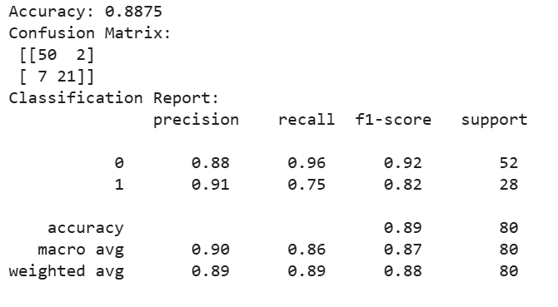
Logistic Regression (Sklearn)
# Logistic Regression
model = LogisticRegression()
model.fit(X_train, y_train)
# Predictions
y_pred = model.predict(X_test)
# Evaluation
print("Accuracy:", accuracy_score(y_test, y_pred))
print("Confusion Matrix:\n", confusion_matrix(y_test, y_pred))
print("Classification Report:\n", classification_report(y_test, y_pred))

Slide 15
Polynomial Regression
import pandas as pd
import numpy as np
import matplotlib.pyplot as plt
from sklearn.preprocessing import PolynomialFeatures
from sklearn.linear_model import LinearRegression
from sklearn.metrics import r2_score
# Load dataset
data = pd.read_csv("Position_Salaries.csv")
# Independent variable (Level) and dependent variable (Salary)
X = data[["Level"]].values
y = data["Salary"].values

Slide 16
Polynomial Regression
# Polynomial transformation (degree=4 for better curve fitting)
poly = PolynomialFeatures(degree=4)
X_poly = poly.fit_transform(X)
# Train polynomial regression model
poly_model = LinearRegression()
poly_model.fit(X_poly, y)
# Predictions
y_pred = poly_model.predict(X_poly)

Slide 17
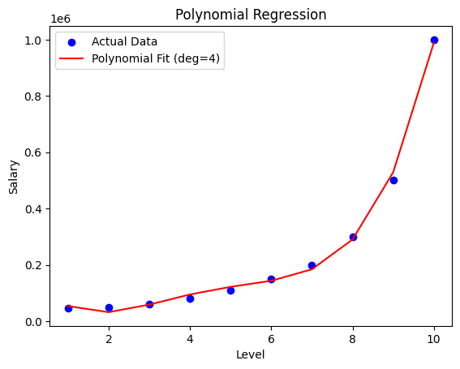
Draw the line….
# Plot results
plt.scatter(X, y, color="blue", label="Actual Data")
plt.plot(X, y_pred, color="red", label="Polynomial Fit (deg=4)")
plt.xlabel("Level")
plt.ylabel("Salary")
plt.title("Polynomial Regression")
plt.legend()
plt.show()

Slide 18

Draw the line….
# Calculate R2 score
r2 = r2_score(y, y_pred)
# Display results
print("POLYNOMIAL REGRESSION METRIC:")
print(f"R² Score: {r2:.4f}")

Slide 19
Activity 1
Predict whether a customer will churn (leave the company) based on their behavior and usage patterns.
Dataset: Telco Customer Churn
Instructions:
Load dataset and preprocess categorical variables ( Encoding).
Train a Logistic Regression model with features like tenure, MonthlyCharges, Contract, InternetService.
Evaluate using Accuracy, Precision, Recall, F1-score.
Plot Confusion Matrix & ROC Curve.

Slide 20
Activity 2
Predict used car prices based on mileage, age, and horsepower.
Dataset: Car Price Prediction
Instructions:
Choose features like Kms_Driven, Year, Engine, Horsepower.
Apply Linear Regression and record performance.
Apply Polynomial Regression (degree=2,3,4) and compare results.
Plot fitted curves for different polynomial degrees.

